Slide 1
WELCOME TO OUR PRESENTATION
Project: CalBalance Bistro
A Comprehensive Implementation of an Innovative Food Ordering System with Enhanced Dietary Systems through Software Development

Slide 2
Submitted By:
Md. Musfiqur Rahman ID: 19202103329
Omme Habiba Sharmin ID: 19202103338
Suha Mehjabeen ID: 19202103326
Md. Aminul Islam ID: 19202103334
Saiful Islam Sumon ID: 19202103456
Supervised By:
Md. Masudul Islam
Assistant Professor,
Dept. of CSE
BUBT

Slide 3
Introduction
Online food ordering addresses the challenges of dining out, providing a flexible and efficient solution for doorstep meal delivery.
Our platform is a vital intermediary, seamlessly integrating consumer experience with diverse cooking alternatives to tackle contemporary dining issues.
A user-centric approach guided our system development, tailored to meet the demands of health-conscious customers.
Prioritizing health, we introduced a calorie limit functionality, which is especially beneficial for those managing diabetes or following specific dietary regimens.
Users can now receive notifications identifying high-calorie or added-sugar meals, empowering them to make informed choices and monitor their dietary patterns.

Slide 4
Objectives
Develop a user-friendly online platform integrating a web application effectively.
Enhance customer convenience through streamlined order processing and secure payment gateways.
Promote healthy lifestyles by integrating alerts for high-calorie or added-sugar foods.
Continuously evolve the platform based on user feedback and performance metrics to meet changing market demands.
Evaluate scalability, adaptability, and system integration to bolster competitiveness and transform the digital food chain.

Slide 5
Existing System
Common problems that existing systems face:
Many platforms experience technical issues such as server downtimes, slow response times, or system crashes.
Inconsistent or outdated menu information which causes order errors and customer dissatisfaction. Failure to revise prices, item availability, or menu descriptions may result in discrepancies.
Systems with overly complex or unintuitive user interfaces lead to difficulty navigating the platform, placing orders, or customizing preferences, especially for less tech-savvy users.
Inadequate customer support and difficulty resolving issues promptly result in dissatisfaction among users facing problems with orders, payments, or the overall ordering process.

Slide 6
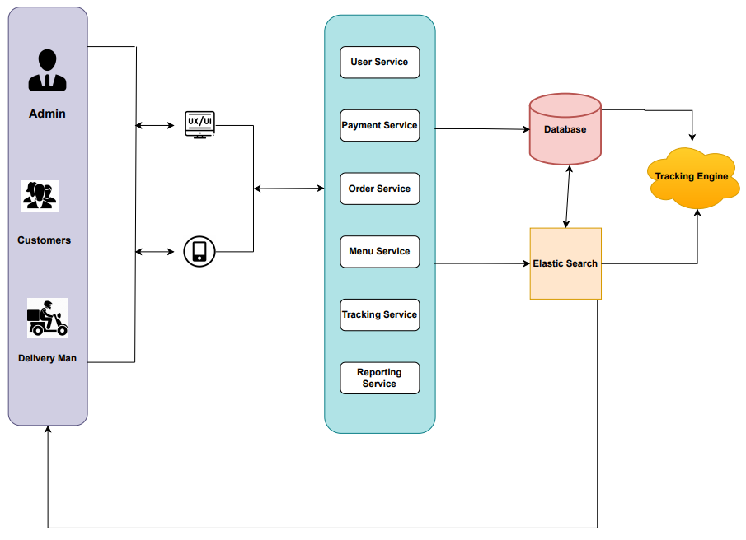
System Architecture

Slide 7
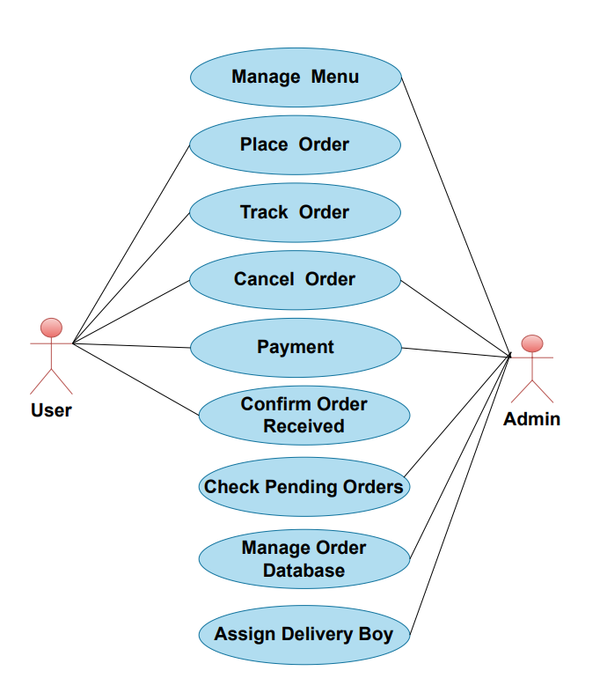
Use Case Diagram
CalBalance Bistro
7

Slide 8
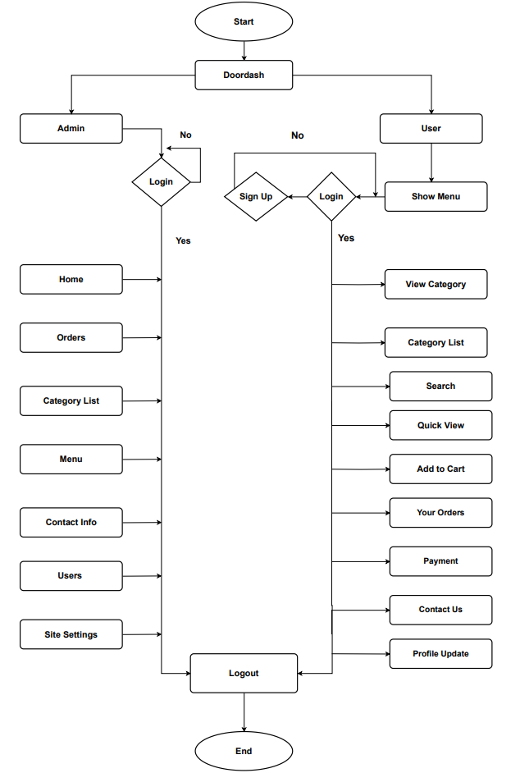
System Flowchart

Slide 9
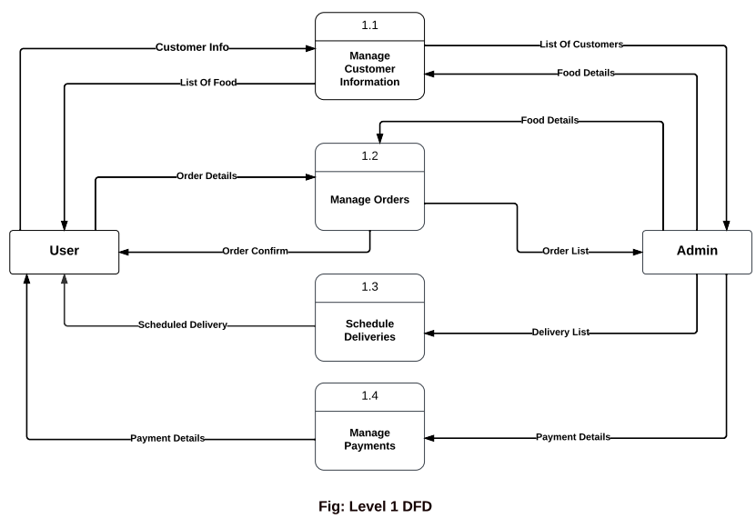
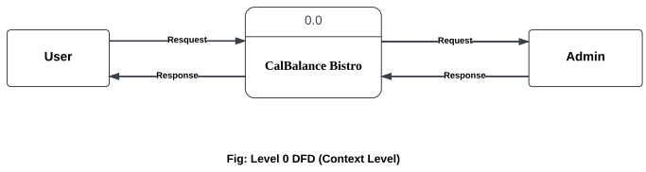
Data Flow Diagram

Slide 10
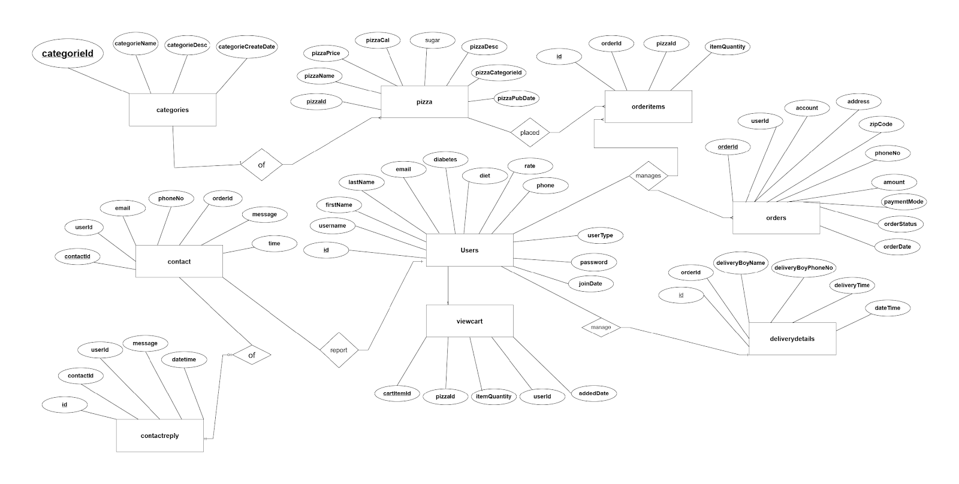
E-R Diagram

Slide 11
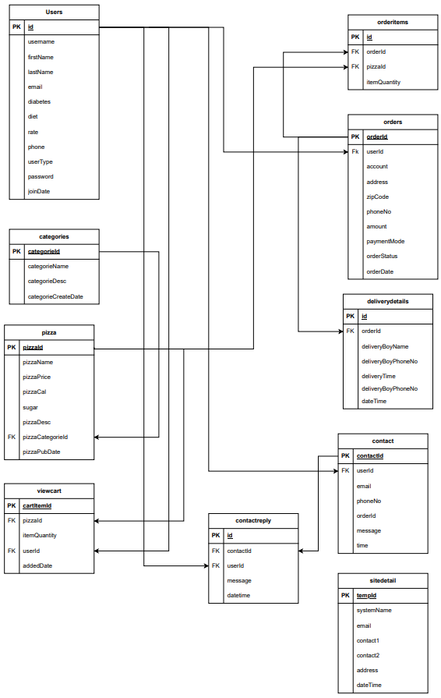
Schema Diagram

Slide 12
Implementation
Let us see our
Project Demonstration

Slide 13
Conclusion
"CalBalance Bistro" is an advanced online meal ordering system emphasizing streamlined and proficient management.
The system's simplicity and user-friendly interface cater to a diverse user base, including those with limited experience.
A key strength lies in the exclusive focus on health information, allowing users to input and monitor calorie intake.
The project establishes the groundwork for future growth, emphasizing ongoing enhancement and dedication to safety and health.
"CalBalance Bistro" aims to be a groundbreaking entity in the market with practical features and a commitment to well-being.

Slide 14
Future Work
Integration of Artificial intelligence and machine learning.
Voice and chatbot integration.
Subscription Services and Loyalty Programs.
Develop systems that can predict user preferences and suggest orders based on Historical data, time of day, and other contextual factors.
Collaboration with other e-payment systems.

Slide 15
Thanks to Everyone

